Slide 1
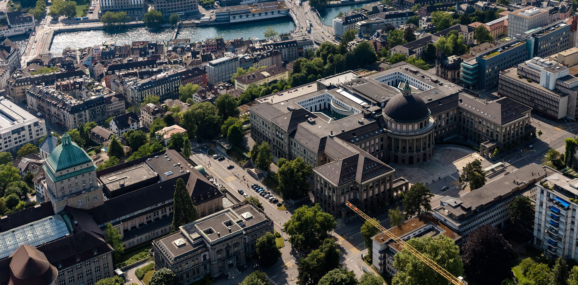
Master‘s thesis montly update
Xiaowei Lin

Slide 2
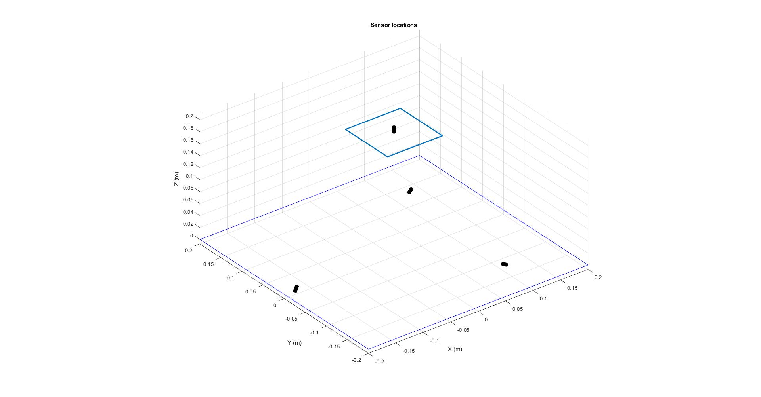
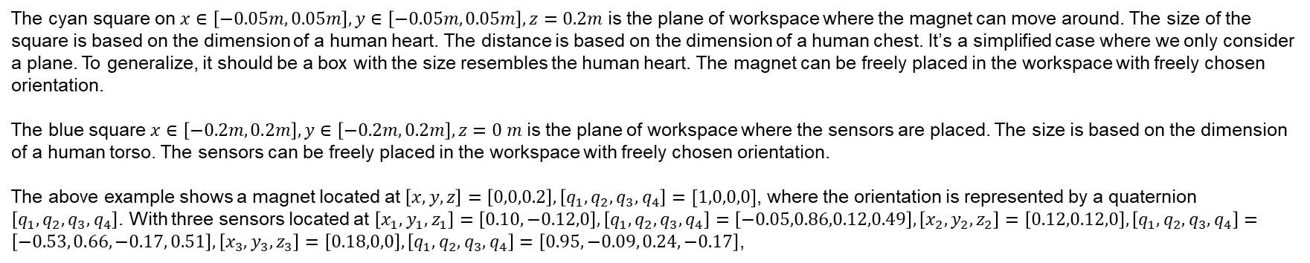
Problem description - recap
The cyan square on $x∈\left[−0.05m, 0.05m\right], y∈\left[−0.05m, 0.05m\right], z=0.2m$ is the plane of workspace where the magnet can move around. The size of the square is based on the dimension of a human heart. The distance is based on the dimension of a human chest. It’s a simplified case where we only consider a plane. To generalize, it should be a box with the size resembles the human heart. The magnet can be freely placed in the workspace with freely chosen orientation.
The blue square $x∈\left[−0.2m, 0.2m\right], y∈\left[−0.2m, 0.2m\right], z=0 m$ is the plane of workspace where the sensors are placed. The size is based on the dimension of a human torso. The sensors can be freely placed in the workspace with freely chosen orientation.
The above example shows a magnet located at $\left[x, y, z\right]=\left[0,0,0.2\right], \left[q_{1}, q_{2}, q_{3},q_{4}\right]=[1,0,0,0]$, where the orientation is represented by a quaternion $\left[q_{1}, q_{2}, q_{3},q_{4}\right]$. With three sensors located at $\left[x_{1}, y_{1}, z_{1}\right]=\left[0.10,−0.12,0\right], \left[q_{1}, q_{2}, q_{3},q_{4}\right]=\left[−0.05,0.86,0.12,0.49\right],\left[x_{2}, y_{2}, z_{2}\right]=\left[0.12,0.12,0\right], \left[q_{1}, q_{2}, q_{3},q_{4}\right]=\left[−0.53, 0.66, −0.17, 0.51\right],\left[x_{3}, y_{3}, z_{3}\right]=\left[0.18,0,0\right], \left[q_{1}, q_{2}, q_{3},q_{4}\right]=\left[0.95, −0.09, 0.24, −0.17\right]$,

Slide 3
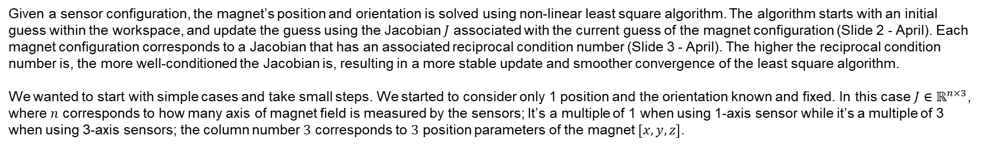
Problem description - recap
Given a sensor configuration, the magnet’s position and orientation is solved using non-linear least square algorithm. The algorithm starts with an initial guess within the workspace, and update the guess using the Jacobian $J$ associated with the current guess of the magnet configuration (Slide 2 - April). Each magnet configuration corresponds to a Jacobian that has an associated reciprocal condition number (Slide 3 - April). The higher the reciprocal condition number is, the more well-conditioned the Jacobian is, resulting in a more stable update and smoother convergence of the least square algorithm.
We wanted to start with simple cases and take small steps. We started to consider only 1 position and the orientation known and fixed. In this case $J∈ℝ^{n×3}$, where $n$ corresponds to how many axis of magnet field is measured by the sensors; It’s a multiple of 1 when using 1-axis sensor while it’s a multiple of 3 when using 3-axis sensors; the column number $3$ corresponds to $3$ position parameters of the magnet $[x, y, z]$.

Slide 4
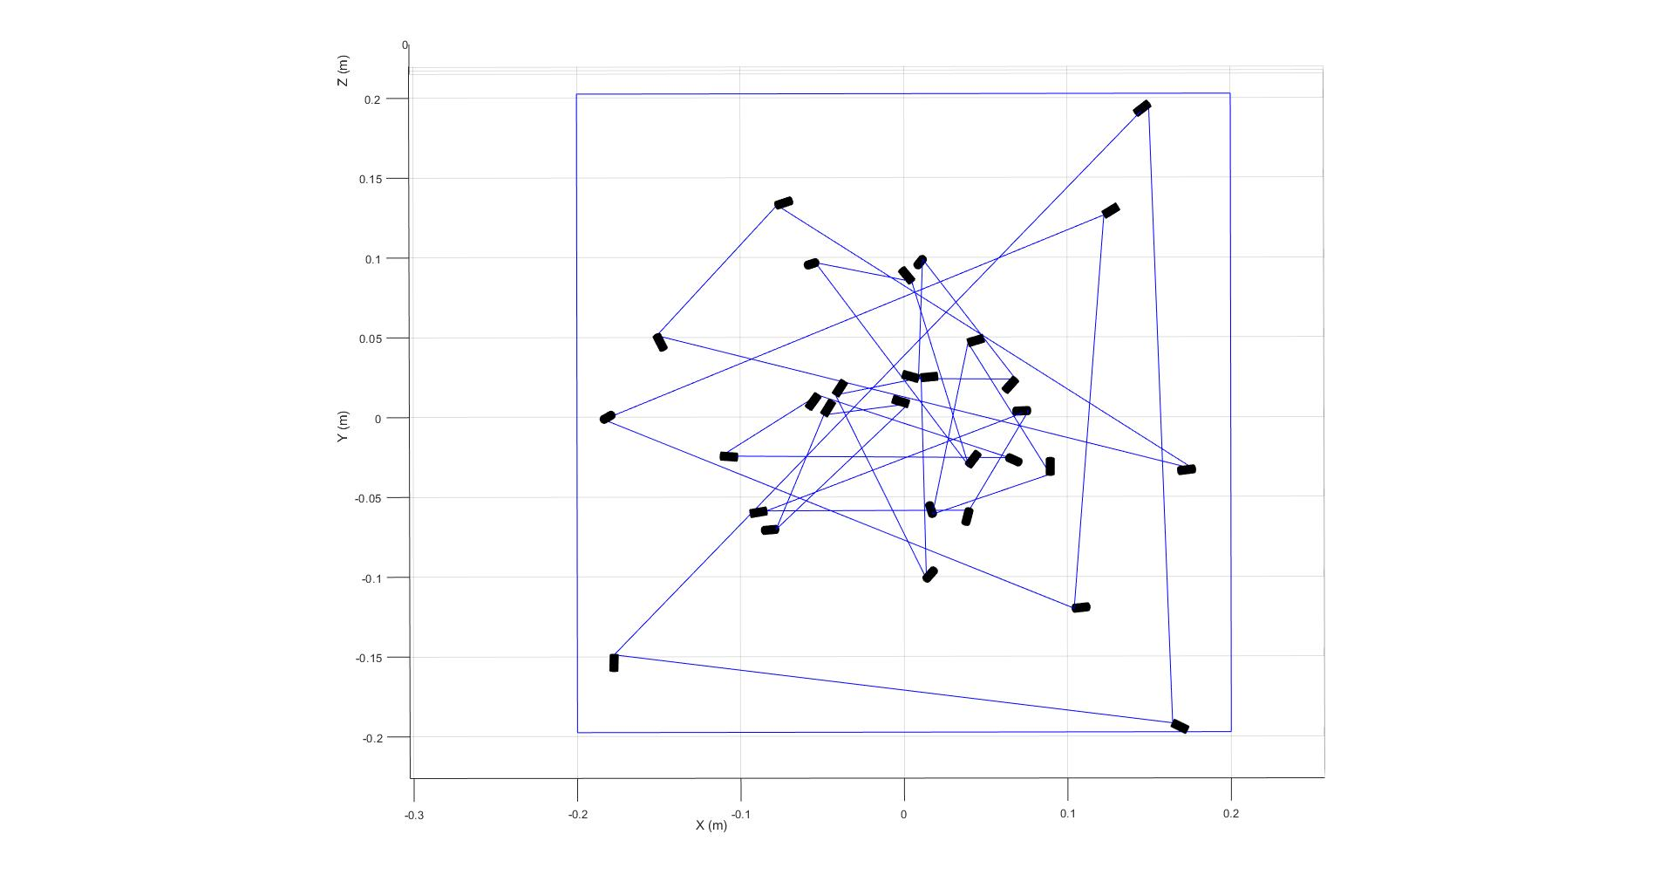
Only 1 position‘s optimal Jacobian
For only 1 position, the Jacobian can be optimal (reciprocal condition number = 1) for different sensors’ location. We tried to find if there is geometric relationship between each solution such that we can generalize the optimal result, at least for only 1 position’s Jacobian. We used genetic algorithm to output 10 sensor configurations that has the optimal result for the center position of the magnet space. And the result is quite random:
We figured it’s overly complicated to generalize the result, even for only 1 position. And we decided to move on to the numerical method, using the genetic algorithm in MATLAB’s optimization toolbox.

Slide 5

Considering multiple magnet‘s positions
It’s easy for the genetic algorithm to find the optimal sensor configuration when only considering one sensor position. However, what we are really interested in is the Jacobian’s property for all magnet’s configurations in the workspace. For that, we take one small step to enlarge the magnet workspace from a single position to a plane of positions at $x∈\left[−0.05m, 0.05m\right], y∈\left[−0.05m, 0.05m\right], z=0.2m$, as shown on slide 2. In the continuous case, there are infinite amount of positions that we are considering, which is impossible to solve. To simplify the problem, we decided to gridify the workspace to a certain amount, and only consider the positions on the grids. To further simplify the

Slide 6
Optimization
The corresponding jacobian for one sensor can be calculated as:
$$\frac{∂B_{i}^{S_{i}}\left(r_{magnet}^{W}\right)}{∂r_{magnet}^{W}}=\frac{∂B_{i}^{S_{i}}}{∂r_{i}^{S_{i}}}\frac{∂r_{i}^{S_{i}}}{∂r_{i}^{w}}\frac{∂r_{i}^{w}}{∂r_{magnet}^{W}}$$
where $r_{i}^{S_{i}}$ is the vector from the magnet position to the sensor $i$’s position, i.e. $r_{i}^{S_{i}}=r_{S_{i}}^{S_{i}}−r_{magnet}^{S_{i}}$, and the $r_{i}^{w}$ is same vector represented in the world frame. This expression of the jacobian is:
$$\frac{∂B_{i}^{S_{i}}\left(r_{magnet}^{W}\right)}{∂r_{magnet}^{W}}=\frac{3μ_{0}}{4π}\frac{\left|μ^{S_{i}}\right|}{{\left|r_{i}^{S_{i}}\right|}^{4}}\left(\left(I−5\hat{r_{i}^{S_{i}}}{\hat{r_{i}^{S_{i}}}}^{T}\right)\left({\hat{r_{i}^{S_{i}}}}^{T}\hat{μ^{S_{i}}}\right)+\hat{μ^{S_{i}}}{\hat{r_{i}^{S_{i}}}}^{T}+\hat{r_{i}^{S_{i}}}{\hat{μ^{S_{i}}}}^{T}\right)∗R_{W}^{S_{i}}∗(−I)$$
where $μ_{0}$ permeability of free space, $μ^{S_{i}}$ is the magnetic dipole moment of the magnet represented in the sensor’s frame, $\hat{μ^{S_{i}}}$ is its corresponding unit vector, $\hat{r_{i}^{S_{i}}}$ is the unit vector for $r_{i}^{S_{i}}$.

Slide 7
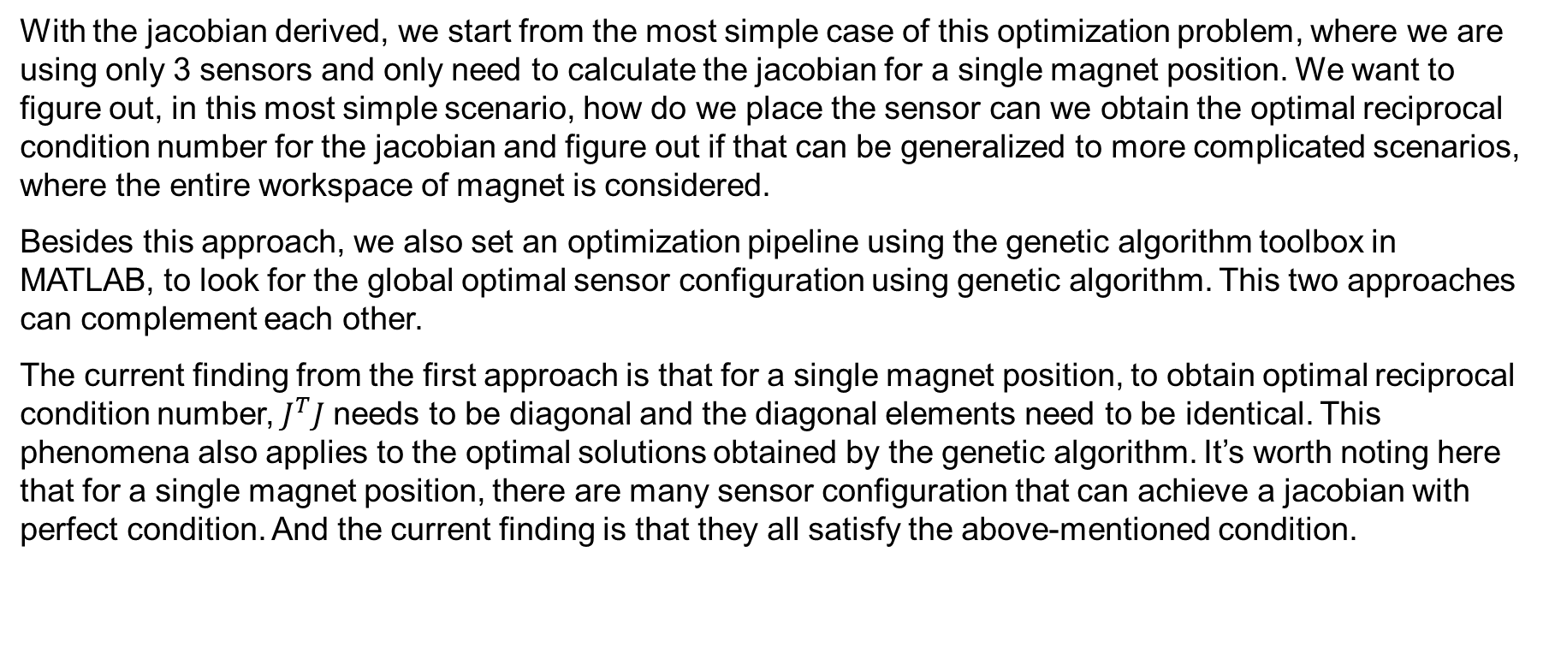
Optimization
With the jacobian derived, we start from the most simple case of this optimization problem, where we are using only 3 sensors and only need to calculate the jacobian for a single magnet position. We want to figure out, in this most simple scenario, how do we place the sensor can we obtain the optimal reciprocal condition number for the jacobian and figure out if that can be generalized to more complicated scenarios, where the entire workspace of magnet is considered.
Besides this approach, we also set an optimization pipeline using the genetic algorithm toolbox in MATLAB, to look for the global optimal sensor configuration using genetic algorithm. This two approaches can complement each other.
The current finding from the first approach is that for a single magnet position, to obtain optimal reciprocal condition number, $J^{T}J$ needs to be diagonal and the diagonal elements need to be identical. This phenomena also applies to the optimal solutions obtained by the genetic algorithm. It’s worth noting here that for a single magnet position, there are many sensor configuration that can achieve a jacobian with perfect condition. And the current finding is that they all satisfy the above-mentioned condition.

Slide 8
Next steps
The latter steps would be to figure out if it’s possible to generalize this finding, if this is viable, the genetic algorithm can be used as a back-up approach. Otherwise, we can still use the genetic algorithm to find the optimal sensor configuration, with the premise that we verify our setup is correct from the simple case where we only consider one magnet position. Then move on to: multiple magnet positions(the entire workspace); adding orientation of the magnet into consideration; adding signal to noise ratio to form a multi objective problem; adding a second magnet to form a constant curvature robot; generalize the magnetic ball chain.

Slide 9
Results comparison: 1 magnet configuration, 4 3-axis sensors
Maximize the reciprocal condition number
Maximize the minimum singular value of J = [Jp, Jo]
Maximize the reciprocal condition number + minimum singular value of J = [Jp,Jo] (2 objectives)
Maximize the minimum singular values of Jp and Jo, respectively (2 objectives)
Maximize the reciprocal condition number + minimum singular values of Jp and Jo (3 objectives)

Slide 10
Results comparison: 1 magnet configuration, 4 3-axis sensors
Maximize the reciprocal condition number
Reciprocal condition number = 0.2022
Minimum(5th) singular value of J = [Jp, Jo] = 4.1e-7
Minimum singular value of Jp = 8.3e-7
Minimum(2nd) singular value of Jo = 1.4e-6
Maximize the minimum(5th) singular value of J = [Jp, Jo]
Reciprocal condition number = 0.1380
Minimum(5th) singular value of J = [Jp, Jo] = 8.5e-7
Minimum singular value of Jp = 4.2e-6
Minimum(2nd) singular value of Jo = 3.5e-6
Maximize the reciprocal condition number + minimum singular value of J

Slide 11
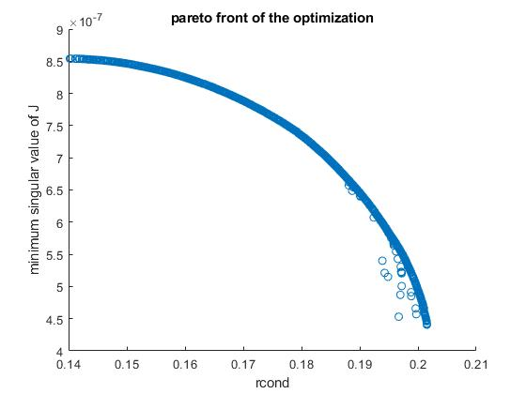
Results comparison: 1 magnet configuration, 4 3-axis sensors
Maximize the reciprocal condition number + minimum singular value of J
Result for 2
Result for 1

Slide 12
Results comparison: 1 magnet configuration, 4 3-axis sensors
Maximize the minimum singular value of Jp and Jo (2 objectives)
The optimization push the sensors to the origin
Reciprocal condition number: ~0
Minimum singular value of J: ~0
Minimum singular value of Jp: 6.6e-6
Minimum singular value of Jo: 4.4e-6
Maximize the reciprocal condition number and the minimum singular values of Jp and Jo (3 objectives)

Slide 13
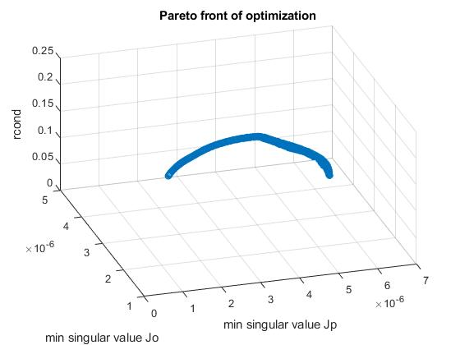
Results comparison: 1 magnet configuration, 4 3-axis sensors
Maximize the reciprocal condition number and the minimum singular values of Jp and Jo (3 objectives)
Result for 4

Slide 14
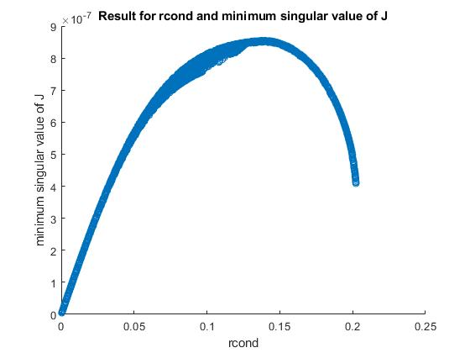
Results comparison: 1 magnet configuration, 4 3-axis sensors
Maximize the reciprocal condition number and the minimum singular values of Jp and Jo (3 objectives)

Slide 15
Results comparison: 1 magnet configuration, 12 1-axis sensors
Maximize the reciprocal condition number
Maximize the minimum singular value of J = [Jp, Jo]
Maximize the reciprocal condition number + minimum singular value of J = [Jp,Jo] (2 objectives)
Maximize the minimum singular values of Jp and Jo, respectively (2 objectives)
Maximize the reciprocal condition number + minimum singular values of Jp and Jo (3 objectives)

Slide 16
Xiaowei Lin
xiaoweilin@student.ethz.ch
EN 353
Boston Children’s Hospital
300 Longwood Ave,
Boston, MA 02115
USA

